Slide 1
The Periodic Table

Slide 2
Døbereiner’s triads
Early in the 1800s Døbereiner noticed regular patterns of behaviour among some elements:
Li – Na – K
Cl – Br – I
Linked it to the arithmetic mean of masses
Only a few triads identified ….

Slide 3
The mid-1800s
Chemists knew about 65 elements by 1860
  Physical properties: solid/liquid/gas
  Melting point, boiling point, density
  Atomic mass relative to hydrogen
  Chemical behaviour: reactions with oxygen, hydrogen, chlorine

Slide 4
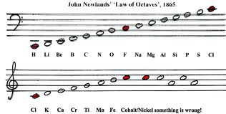
Newlands’ octaves
Regular repeating pattern of properties when arranged in order of increasing mass
But: he placed Fe with O and S???!!!

Slide 5
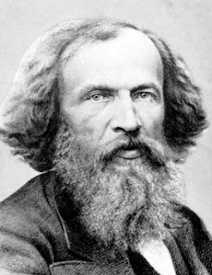
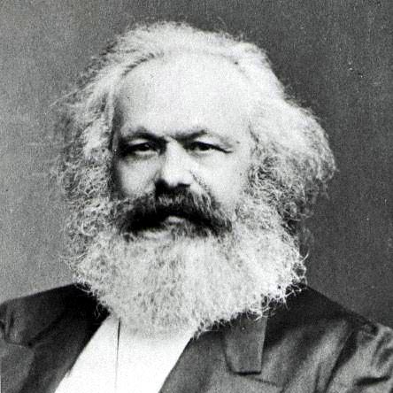
Quick Quiz
The modern periodic table is associated with which famous man with a big beard?

Slide 6
Quick Quiz
The periodic table is associated with which famous man with a big beard?
Sorry Karl!

Slide 7
Mendeleev’s table
Recognised that atomic mass might not be a good guide to position - particularly where masses of elements were similar.
Used chemical knowledge to position the elements.
Supposed that there were still elements to be discovered
Predicted properties of unknown elements based on known elements
Placed difficult elements in a separate group.

Slide 8
Mendeleev
"If all the elements are arranged in the order of their atomic masses, a periodic repetition of properties is obtained. This is expressed by the law of periodicity."
Dmitri Mendeleev, Principles of Chemistry, Vol. 2, 1902, P. F. Collier, p17.

Slide 9
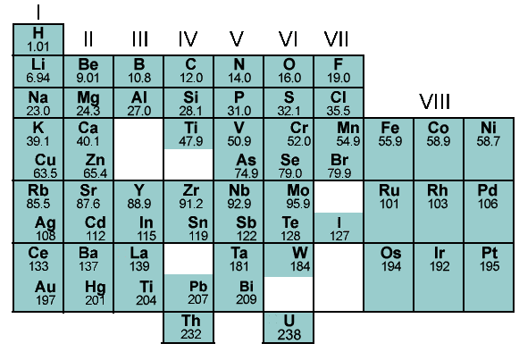
Mendeleev’s table

Slide 10
Mendeleev’s table

Slide 11
Mendeleev’s table
44?
72?
44 = gallium discovered in 1875
72 = germanium discovered in 1886

Slide 12
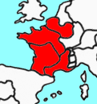
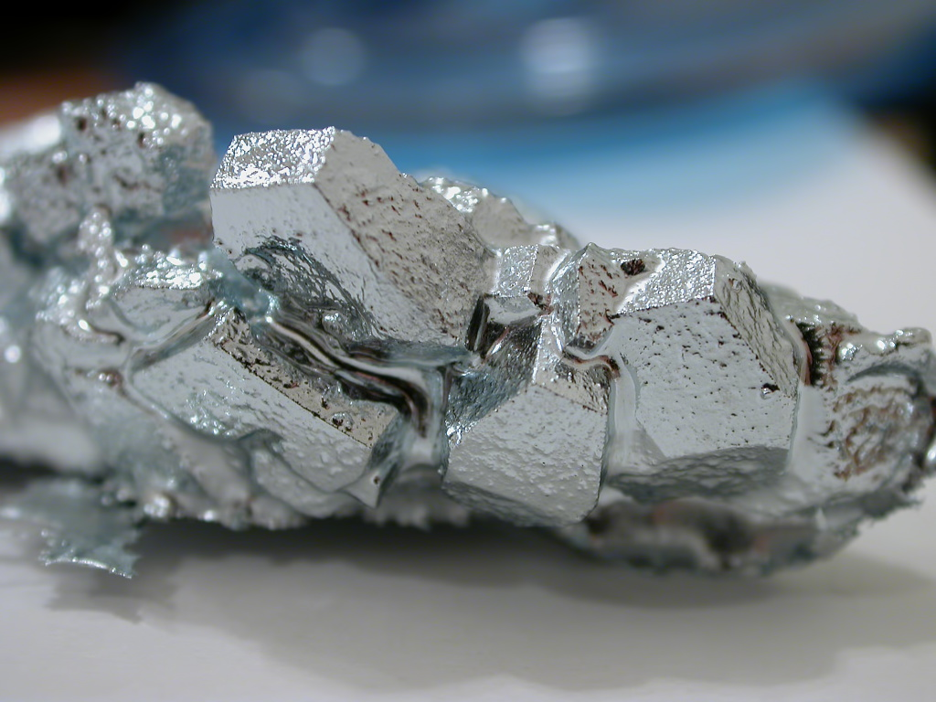
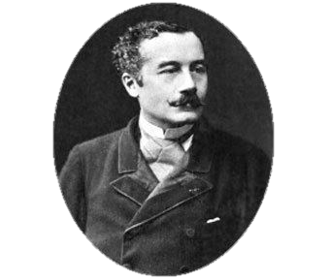
New elements: gallium - 1875
Paul Emile Lecoq de Boisbaudran

Slide 13

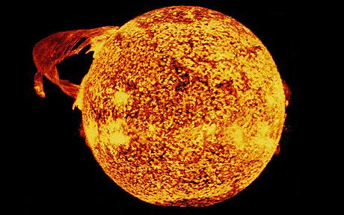
New elements: the noble gases
Discovered in the 1890s
A problem for Mendeleev - where to place them?
Chemically and physically they are all similar
Masses indicated that they belonged to their own group beyond Mendeleev’s group VII.

Slide 14
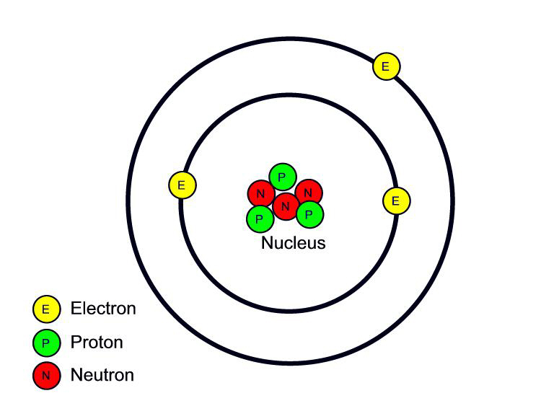
Atomic number «Z»
Early 20th Century: discovery of atomic structure
  Protons
  Neutrons
  Electrons
Moseley: measurement of the number of protons in a nucleus by x-ray methods.

Slide 15
Chemical symbols
Each element is shown with a symbol
  Mass number = number of protons + neutrons
  Atomic number = number of protons
Au
197
Mass number
79
Atomic number

Slide 16
The modern table
Elements in order of increasing Z

Slide 17
The modern table
Groups = down; rows = across

Slide 18
The modern table
Organised in blocks = electronic structure
p-block
s-block
d-block
f-block

Slide 19
The modern table
Metals, semi-metals, non-metals
non-metals
metals
semi-metals

Slide 20
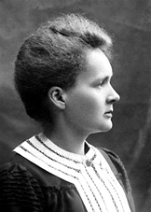
Marie Curie
Ra
Radium

Slide 21
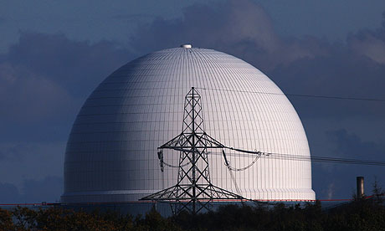
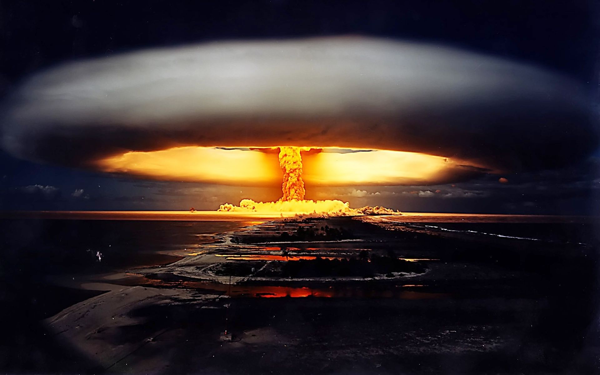
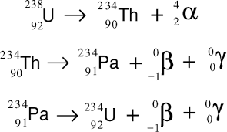

Slide 22
The modern table
Chemical and physical properties of elements vary in regular and predictable ways
across the periods
down the groups
This is because of the regular variation in atomic structure.

Slide 23
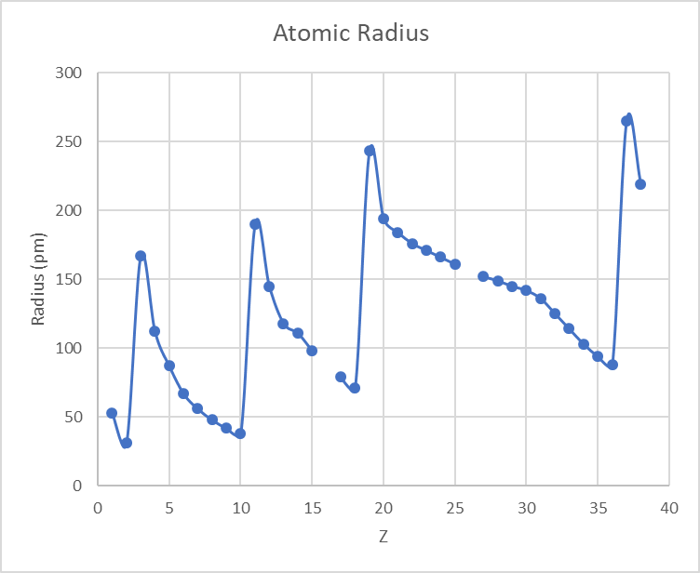

Slide 24
Li Na K Rb
H He Ne Ar Kr

Slide 25
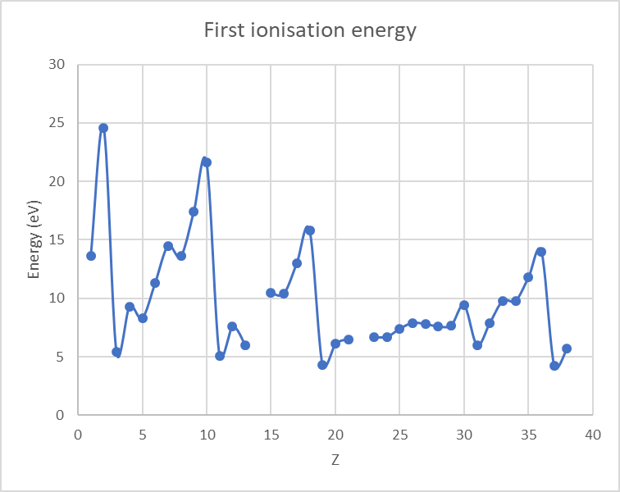
X → X⁺ + e⁻

Slide 26
H He Ne Ar Kr
X → X⁺ + e⁻
Li Na K Rb

Slide 27
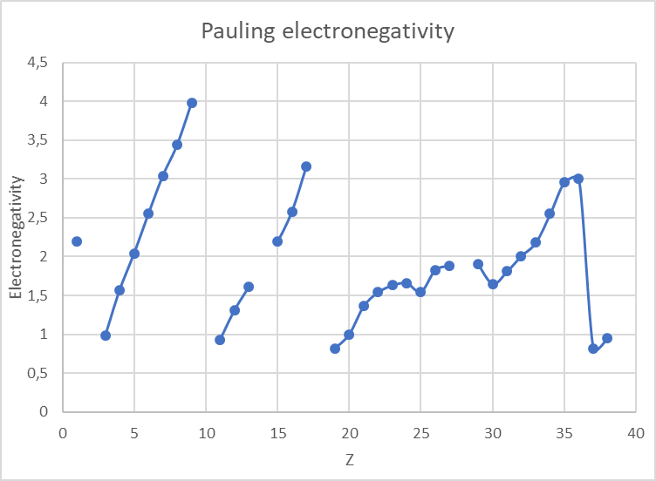

Slide 28
H He Ne Ar Kr
Krypton!
Li Na K Rb

Slide 29
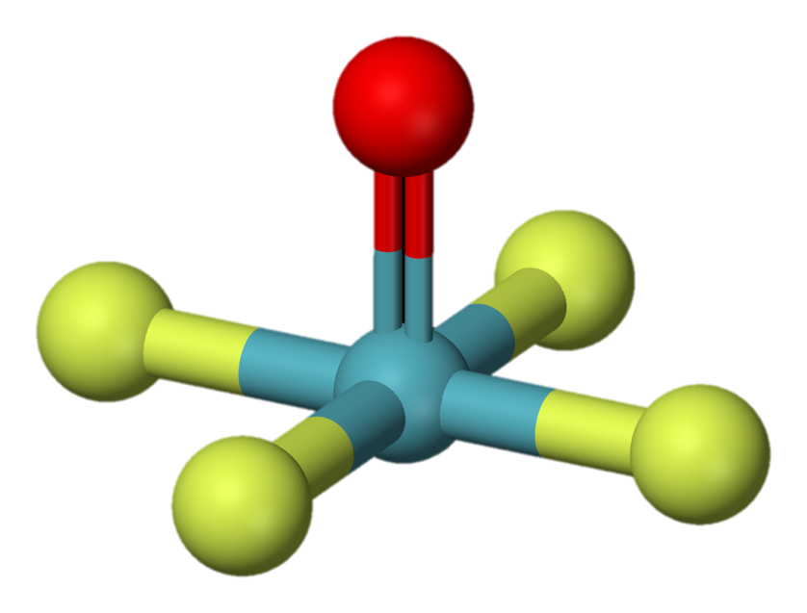
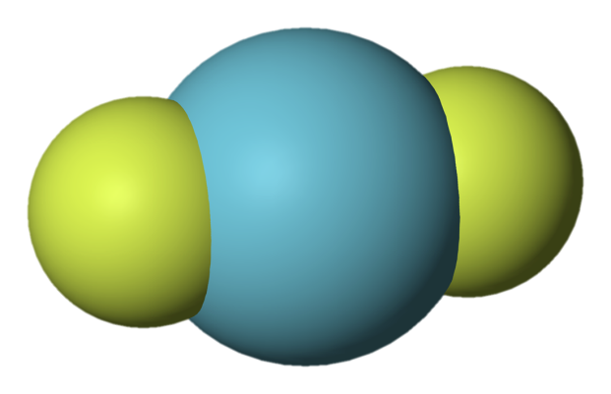
Noble compounds!
Xenon oxytetrafluoride
Krypton difluoride

Slide 30
Electron shells
A shell corresponds to a period in the table
Increase in energy down the table
A full set of electrons in the outermost shell is stable.

Slide 31
Looking at Groups
The elements in a group all have the same number of electrons in the outer shell.
The electrons are responsible for the chemical behaviour.
Elements in a group behave in similar ways.
The physical properties vary in a regular way down the group.

Slide 32
Looking at groups
Let’s start with group VIII.

Slide 33
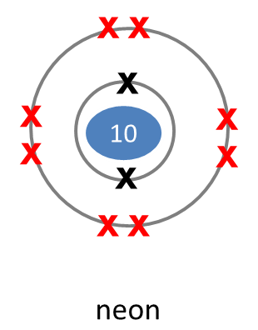
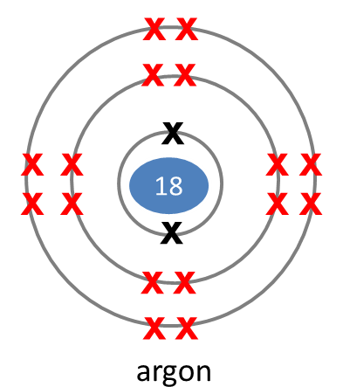
Group VIII: the noble gases
Unreactive
Eight electrons in outer shell*
Shell is full:
  Can’t accept e⁻
  Don’t want to give e⁻
Noble: like kings they stay apart from the normal reactions of other elements
*Apart from He which has only two and valid for 2° and 3° row

Slide 34
Adding one proton to a noble gas..
the alkali metals.

Slide 35
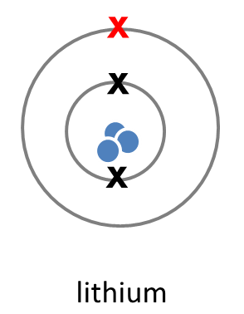
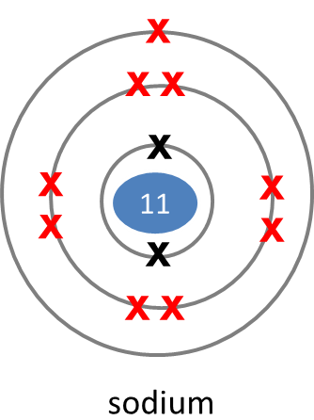
Group I: alkali metals
Soft metals
1 electron in the outer shell
They react to attain a full shell by losing an electron:
Na | → | Na⁺ | + | e⁻

Slide 36
Group I: alkali metals
Highly reactive
Reactivity increases down the group (why?)
  Li < Na < K < Rb < Cs
React with water to generate hydrogen gas:
Dara O Brien Royal institution – my favourite element
https://www.youtube.com/watch?v=6Gmi9wRC5OY
2Na | + | H₂O | → | 2NaOH | + | H₂ (g)

Slide 37
Removing one proton from a noble gas
the halogens.

Slide 38
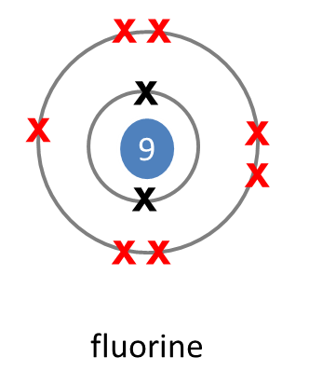
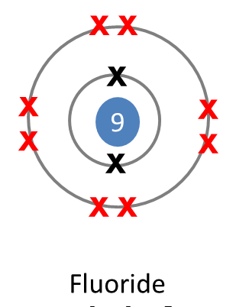
Group VII: halogens
Non-metals
  F, Cl = gas; Br = liquid; I = solid
Highly reactive:
  Reactivity decreases down the group.
  F > Cl > Br > I
7 electrons in the outer shell
  React to complete the shell with eight electrons by gaining an electron
-

Slide 39
Group VII: halogens
React to have a filled outer shell by gaining an electron:
React with metals to form salts which have the ending “-ide”
Cl₂ | + | e⁻ | → | 2Cl⁻
Cl₂ | + | Mg | → | MgCl₂
I₂ | + | Na | → | NaI

Slide 40
Summary
The periodic table is based on increasing number of protons in the nucleus which equals the number of electrons in the element.
The electrons are organised in shells.
The electrons in the outer shell determine the chemistry
The physical properties of the elements vary in a predictable manner across the rows and down the groups.

Slide 41
End of section

