Slide 2
Atoms

Slide 3
Summary
History
Spectroscopy
Models
  Parts of the atom
How are the electrons arranged?
  The Bohr model - orbits
  Schroedinger – orbitals
  Electronic structures

Slide 4
How do we know about atoms?
Speculation
Spectroscopy
Atomic models
Quantum mechanics
Democritus and Dalton
Bunsen and Balmer
Thomson and Rutherford
Bohr and Schroedinger

Slide 5
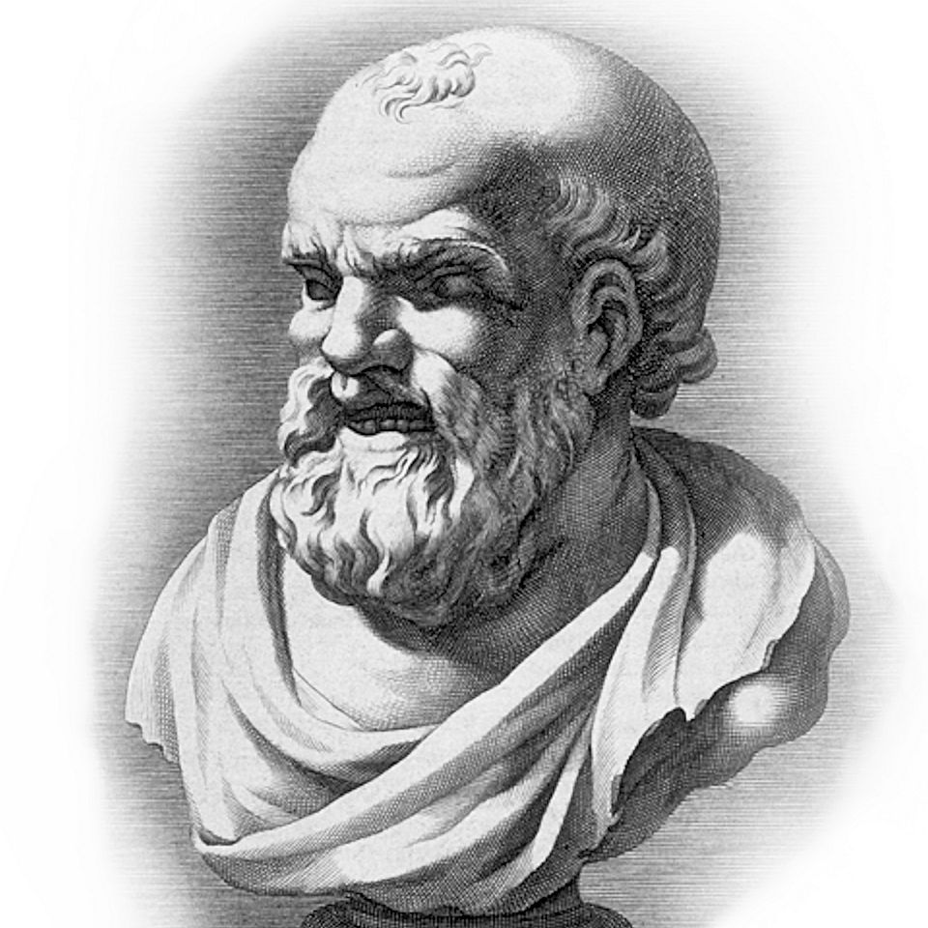
Democritus
The laughing philosopher
"By convention bitter, by convention sweet, but in reality atoms and void".
Everything is made up of tiny pieces
http://math-science-resources.com/wp-content/uploads/2016/09/democritus.jpg

Slide 6
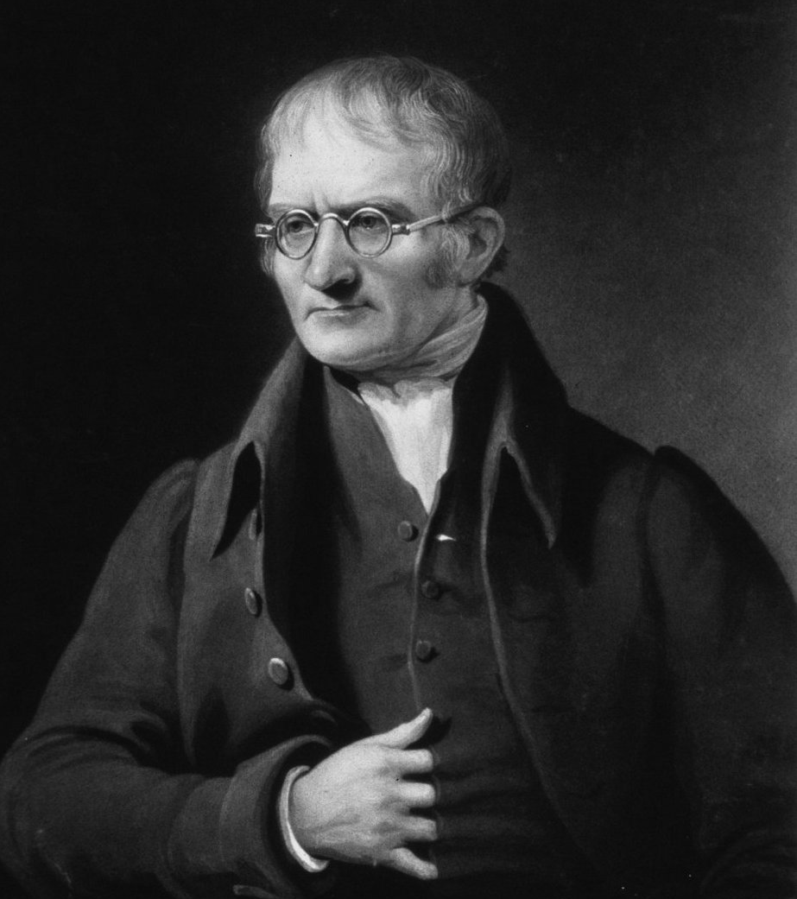
John Dalton
1766-1844
Described Daltonism
Developed a theory of atoms
Supported Manchester United

Slide 7
Dalton’s postulates
elements, in their purest state, consist of particles called atoms
atoms of a specific element are all the same, down to the very last atom;
atoms of different elements have different atomic weights
atoms of elements unite to form chemical compounds;
atoms are neither created nor destroyed in chemical reaction, only their arrangement changes.

Slide 8
Spectroscopy
If matter is made of atoms, how can we find out what they are?

Slide 9
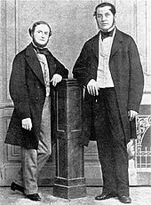
Bunsen and Kirchoff
Studies of heated metal salts
Invention of the spectroscope
Discovery of caesium and rubidium
Formulation of laws of spectroscopy

Slide 10
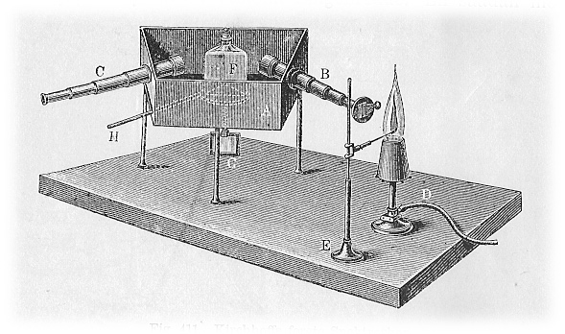
The spectroscope
A solid, liquid, or dense gas excited to emit light will radiate at all wavelengths and thus produce a continuous spectrum.
A low-density gas excited to emit light will do so at specific wavelengths and this produces an emission spectrum. (See also: emission spectrum)
If light composing a continuous spectrum passes through a cool, low-density gas, the result will be an absorption spectrum.
By Poul la Cour &amp; Jacob Appel - Historisk Fysik bind I, Public Domain, https://commons.wikimedia.org/w/index.php?curid=2913632

Slide 11

The spectroscope
Light source
Slit
Diffraction grating
spectrum
observer
Instructions to build one: https://publiclab.org/wiki/papercraft-spectrometer

Slide 12

Light sources
The sun, stars, lamps…
Using a spectroscope we can observe the spectra of these light sources.
We can see different types of spectra according to the light source.
https://skyandtelescope.org/astronomy-resources/the-spectral-types-of-stars/

Slide 13
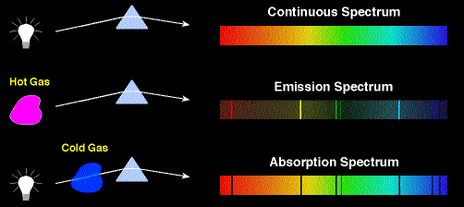
What is a spectrum?
We can split white light into its component parts with a prism.
  Going from red to violet, the wavelength of the light shortens and the frequency of the light wave and hence the energy increases.

Slide 14
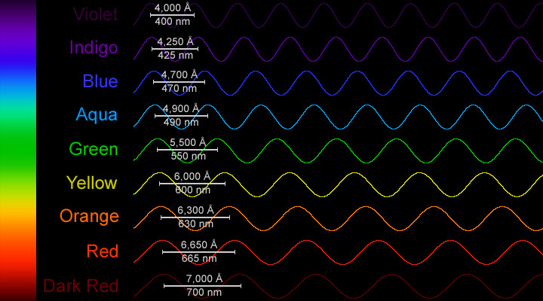
Light - wavelength

Slide 15
Three situations: (1)
A solid, liquid, or dense gas excited to emit light will radiate at all wavelengths and produce a continuous spectrum.

Slide 16
Three situations: (2)
A low-density gas excited to emit light will do so at specific wavelengths and this produces an emission spectrum
A low-density gas excited to emit light will do so at specific wavelengths and this produces an emission spectrum

Slide 17
Three situations: (3)
If light composing a continuous spectrum passes through a cool, low-density gas, the result will be an absorption spectrum.

Slide 18
Three situations:

Slide 19
Three situations:
These spectra tell us about what is happening inside the atoms of the gas

Slide 20
The spectroscope (a reminder)
Light source
Slit
Diffraction grating
spectrum
observer
Instructions to build one: https://publiclab.org/wiki/papercraft-spectrometer

Slide 21
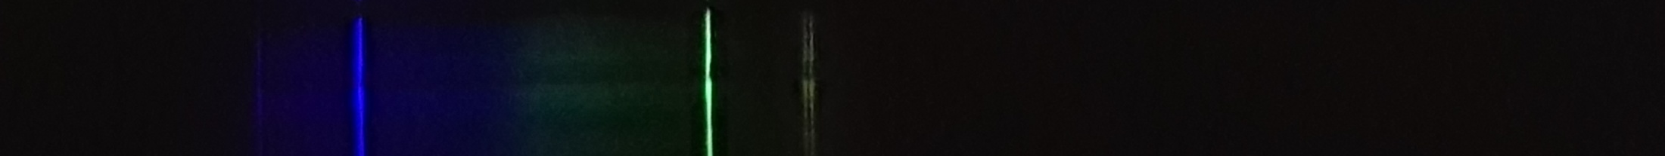
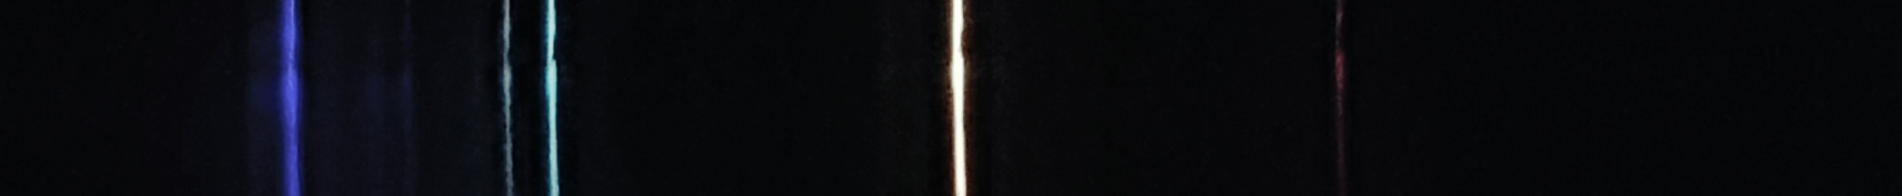
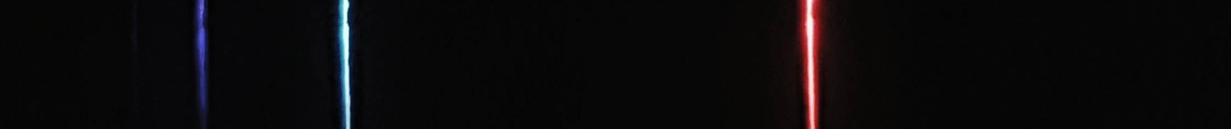
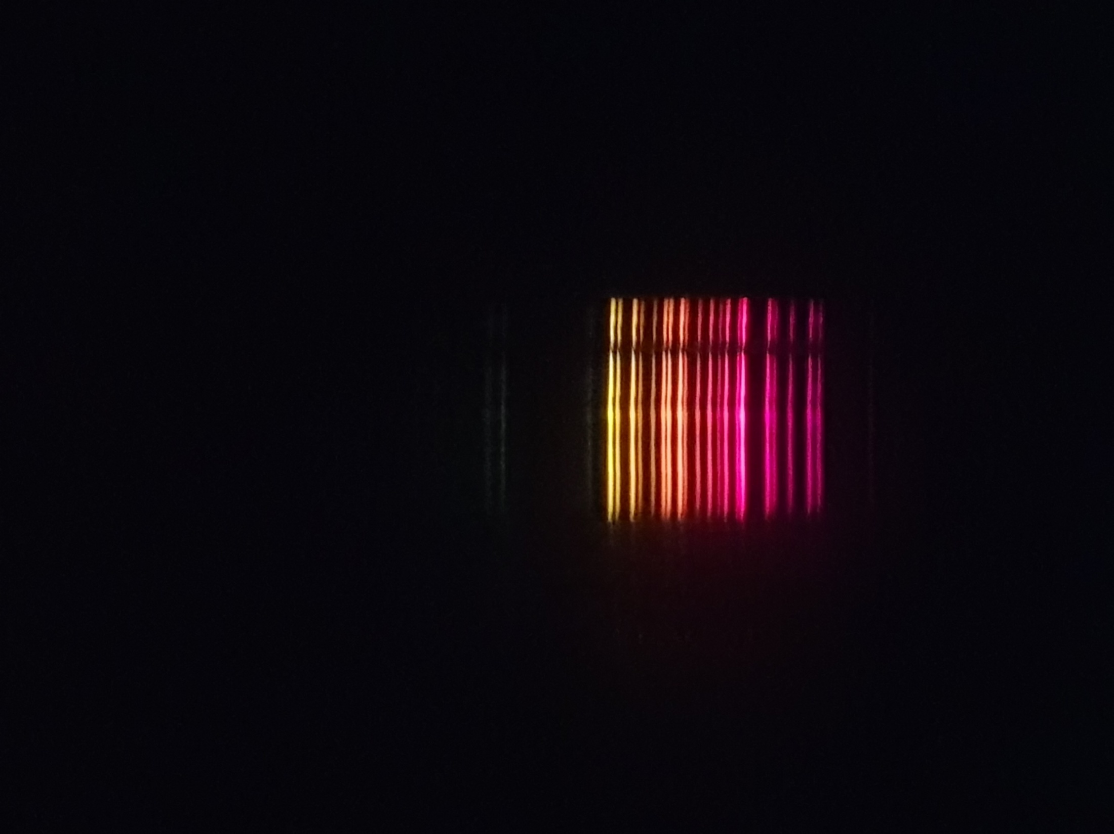
Emission spectra
Each element gives a different set of lines
Mercury
Helium
Hydrogen
Neon

Slide 22


Hydrogen
Which line has the longest wavelength?
Which line has the highest frequency?
Which line has the highest energy?
  E = hν (v = frequency, h = Planck’s constant)
enhanced

Slide 23
A spectroscope

Slide 24
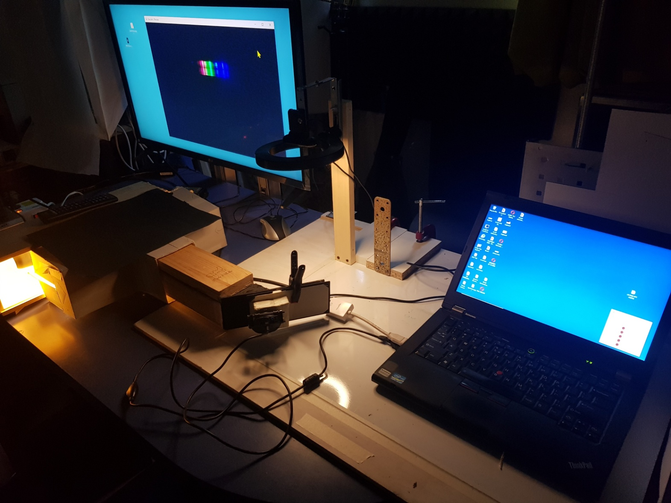
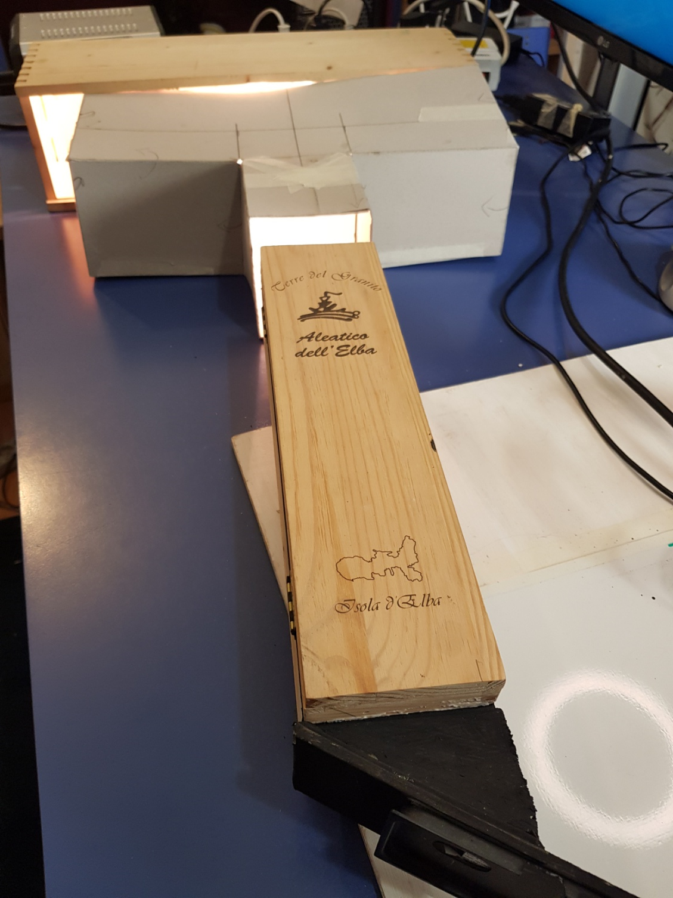
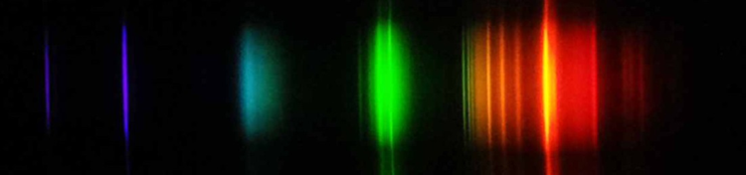
Light sources
Closed box = tube
Webcam or phone
Grating holder
(inside)
Compact Fluorescent Light
Smartphone holder

Slide 25


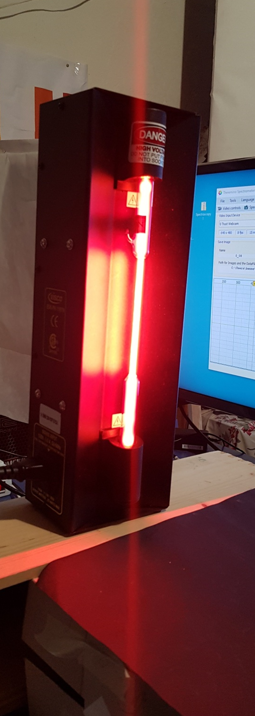
Emission tube

Slide 26
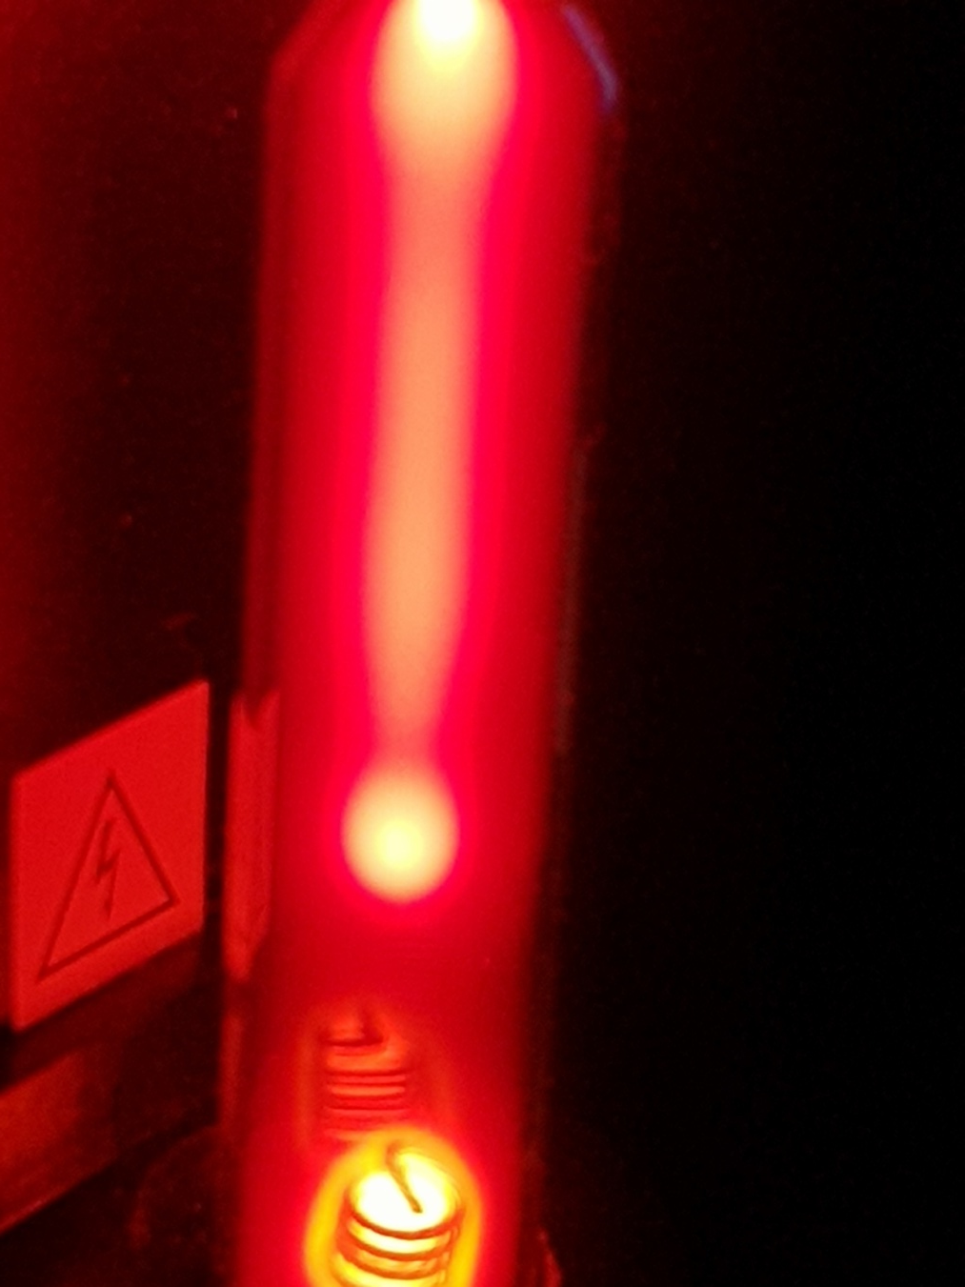

Slide 27


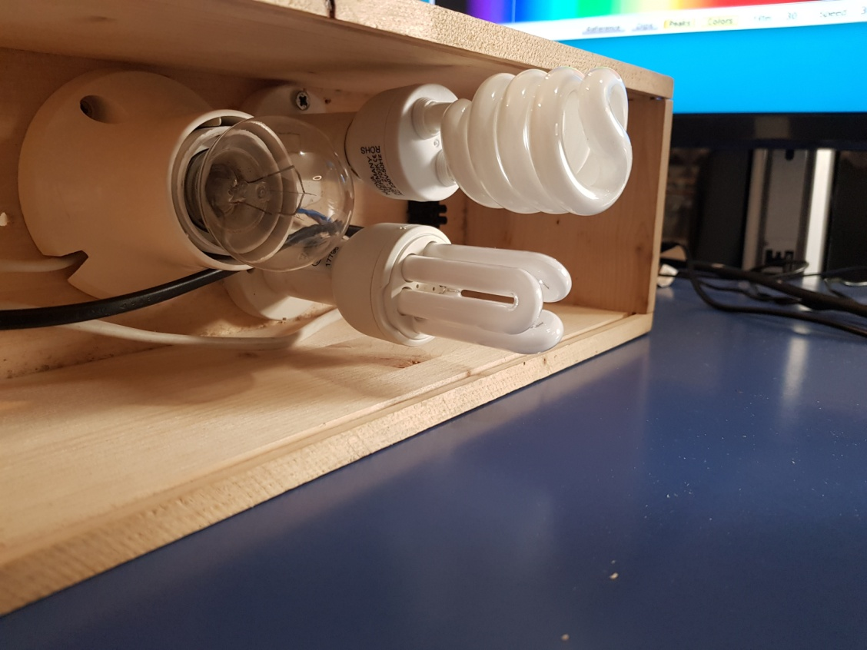
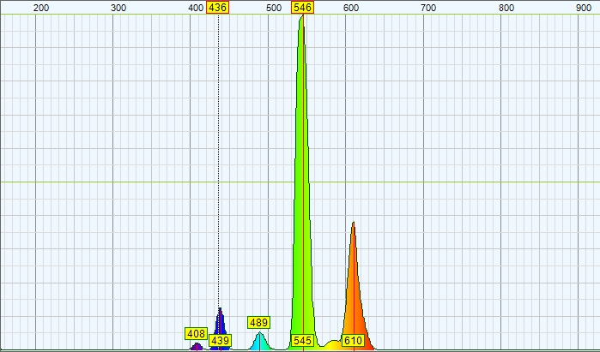
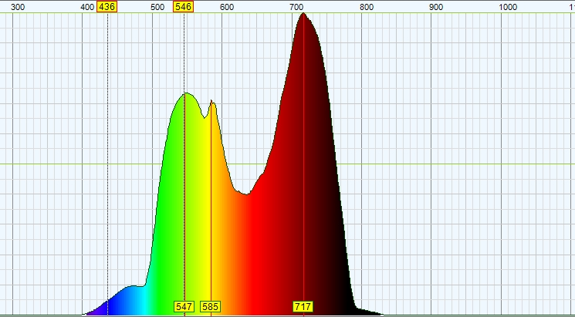
Compact fluorescent light = emission
Incandescent light = continuous

Slide 28
Compact fluorescent light = emission
Incandescent light = continuous
Infra-red!

Slide 29

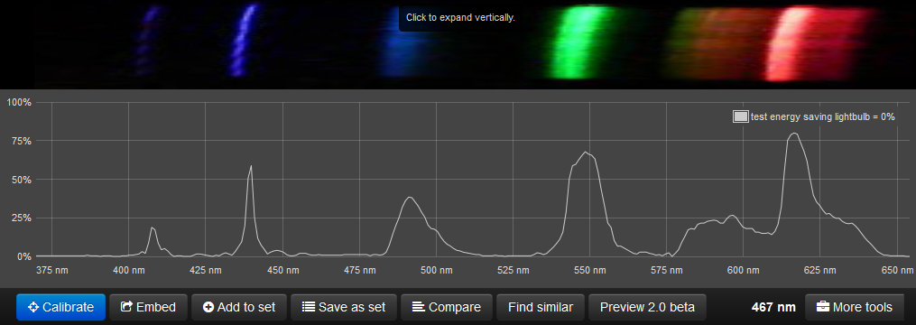
Hg²⁺
Hg²⁺
Eu³⁺
Tb³⁺
Hg²⁺
Hg²⁺
Mercury 2 line: "middle blue line" at 435.833 nanometers
Mercury 3 line: "bright green line" at 546.074 nanometers
Analysed using http://spectralworkbench.org/
Identities of lines: http://www.euhou.net/index.php/exercises-mainmenu-13/classroom-experiments-and-activities-mainmenu-186/179-observations-of-various-spectra-with-a-home-made-spectroscope

Slide 30
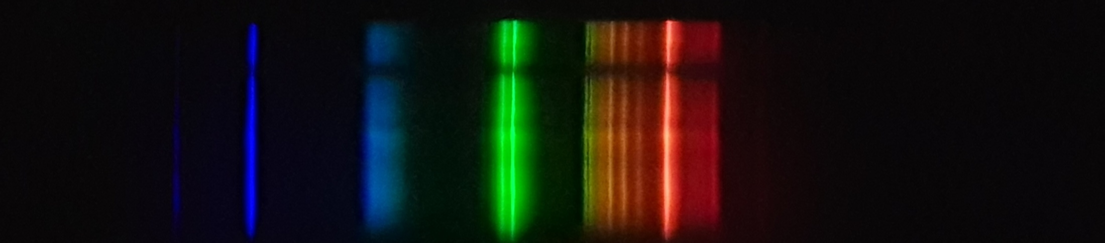
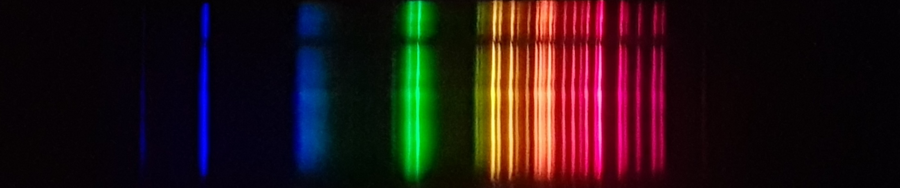
Neon
Preliminary results with neon emission tube and CFL
Hg2+ 435
Hg2+ 546
CFL
These lines are known, so we can use them to calibrate the scale...
Neon + CFL

Slide 31
Inside the atom

Slide 32
Atoms
Atoms are made up of protons and neutrons in the nucleus and electrons around the nucleus
Protons
  are positively charged.
  Identify the element = no. of protons (atomic number Z)
Neutrons
  Reduce effect of charge on proton
  Similar mass to protons
  All atoms contains neutrons except hydrogen
Electrons – are responsible for chemistry.

Slide 33
Thomson – the electron
"To the electron - may it never be of any use to anybody."
Thomson discovered the electron in 1897 through experiments with a cathode ray tube

Slide 34
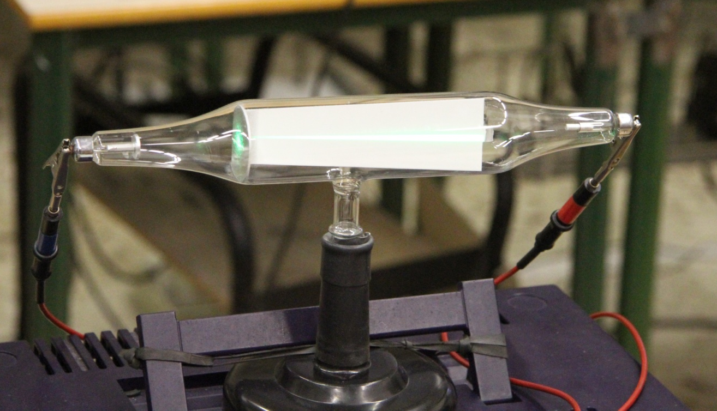
+
-
Gas discharge tube
+
-
+
-
+
+
Beam deflected by –ve plate

Slide 35
Electrons
Negatively charged
Balance charge on protons
1/1800 mass of proton
Electrons are responsible for how the atom behaves i.e. the chemistry that we can observe when we do chemical reactions.

Slide 36
Rutherford
Rutherford demonstrated in his famous gold foil experiment that the atom is mostly empty space and contains a small compact nucleus surrounded by a cloud of electrons
The nucleus contains positive charge

Slide 37
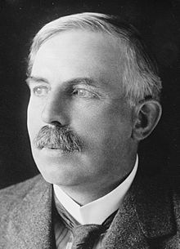
The Geiger-Marsden experiment
Alpha particle source with slit
Gold foil
FSU simulation
Zinc sulphide screen

Slide 38
Bohr et al

Slide 39
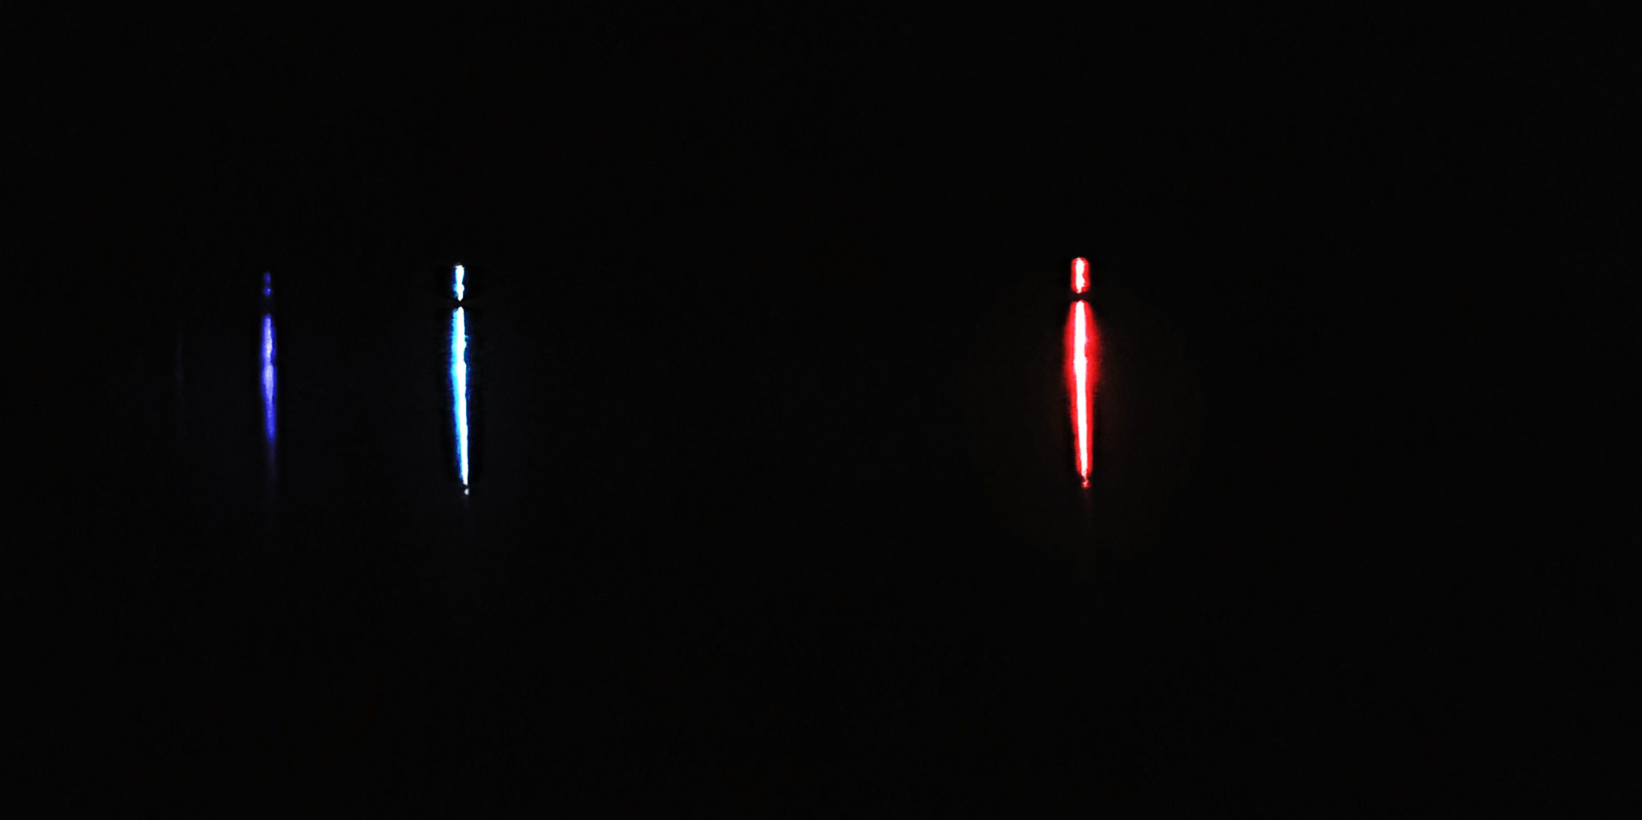
Returning to hydrogen
The visible lines are caused by transitions to the second orbit.
They follow a pattern of decreasing distance between the lines as the wavelength gets shorter.
Wavelength gets shorter

Slide 40
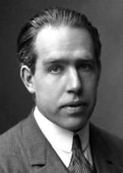
The Bohr model of hydrogen
Hydrogen is the simplest atom: it contains one proton and one electron
Niels Bohr proposed a model of the hydrogen atom to explain the observed spectrum of hydrogen.

Slide 41
The Bohr model of hydrogen
He assumed that the electron is located in one of a series of orbits around the nucleus.
Each orbit has a defined energy and different orbits have different energies.
As the orbits increase in size (radius), they are further from the nucleus and have higher energy and get closer together

Slide 42
The Bohr model of hydrogen
When the electron absorbs energy it moves to a higher orbit.
It releases this energy to go back to a lower energy orbit.
The energy is released in defined amounts: a quantum
  E = hv (v = frequency, h = Planck’s constant)
    Higher frequency = more energy

Slide 43
The Bohr model of hydrogen
When the electron absorbs energy it moves to a higher orbit.
It releases this energy to go back to a lower energy orbit.
The energy is released in defined amounts: a quantum
  E = hν
  (ν = frequency, h = Planck’s constant)

Slide 44
The Bohr model of hydrogen
The lines that we observe in the spectrum of hydrogen are the result of this process.
The frequency of the light emitted is proportional to the energy difference between the orbits.
Bigger jump = more energy = higher frequency
5
4
3
2
1
  E = hν

Slide 45

The spectrum of hydrogen
When we pass an electric current through hydrogen gas and we look at the spectrum we can see bright lines described by Balmer
Physicist Niels Bohr proposed that these lines are caused by the electron moving in the hydrogen atom – but how?
Remember that in the tube: H₂ (g) → 2H (g)

Slide 46

Bohr’s model
red
violet
Excited electron falls from level 4 back to level 2 emitting visible light
orbits
6
5
4
3
2
n = 6 5 4 3 2 1

Slide 47
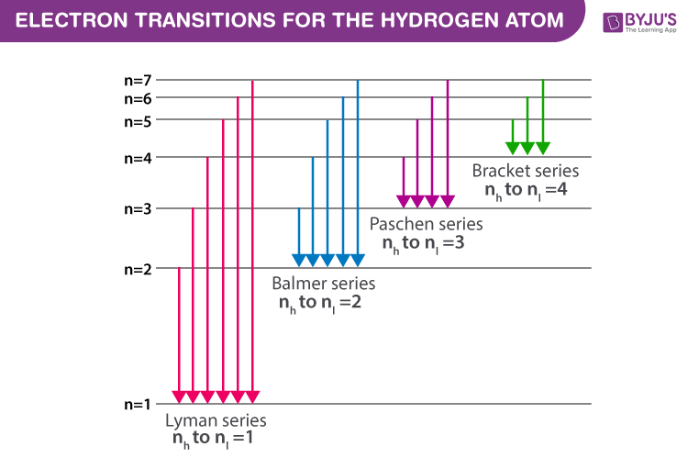
The full spectrum of hydrogen
There is another series discovered by Lyman in the violet part of the spectrum (higher energy) caused by transitions to the lowest orbit (first orbit).
There are other series each corresponding to transitions to increasingly higher orbits.
http://1.bp.blogspot.com/_nxSb3loAy3A/TGedfwHgN8I/AAAAAAAAAN8/JhEss5aeCE8/s1600/h-atom.gif
IR
visible

Slide 48
Why do we see more than one line?
When the hydrogen atom absorbs an amount of energy corresponding to the difference between n=1 and some higher value of n, the atom is in an excited state.
Excited states quickly decay to the ground state but not necessarily in a single transition
E.g. The n=1→3 excitation can give three emission lines: n=3→1, n=3→2, and n=2→1.
There are many atoms of hydrogen in the gas – each in a different state
5
4
3
2
1
excited state
ground state

Slide 49
Why do we see more than one line?
5
4
3
2
1
Line 2 in the Balmer series
Line 3 in the Lyman series
Line 1 in the Lyman series

Slide 50
Problems with Bohr’s model
Contradicts what was known about the movement of a charge in an electric field: when a charge changes direction it must radiate energy – the electron should lose energy and fall towards the nucleus.
It is deterministic which means that we should be able to calculate where the electron is at any particular moment in time. However, this isn’t possible.
It explains the observed spectrum of hydrogen very well but it doesn’t explain the spectra of larger atoms.

Slide 51
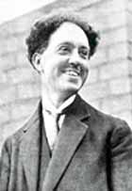
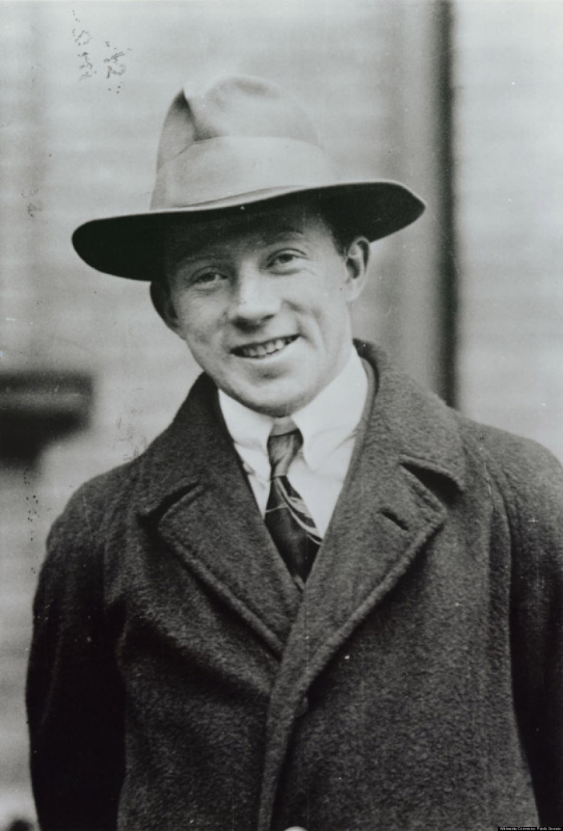
Waves and Particles
De Broglie:
  Proposed that particles can behave as waves (concept of duality).
  λ = h/ mν
Heisenberg:
  It is not possible to measure the position of an electron and its velocity at the same time: we can never be certain where the electron is.
  To explain electrons we need a model which is not deterministic.

Slide 52
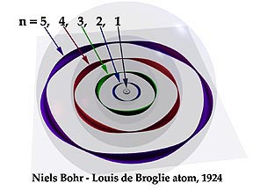
Standing waves
A further development of the model was to consider the electron as a wave confined to an orbit
The wave should have an integral number of wavelengths around the circle.
This condition can only be met if the circumference of an orbit can exactly accommodate an integral number of wavelengths.
Thus only certain discrete orbital radii and energies are allowed
http://www.kennethsnelson.net/atom/Portrait1.html

Slide 53
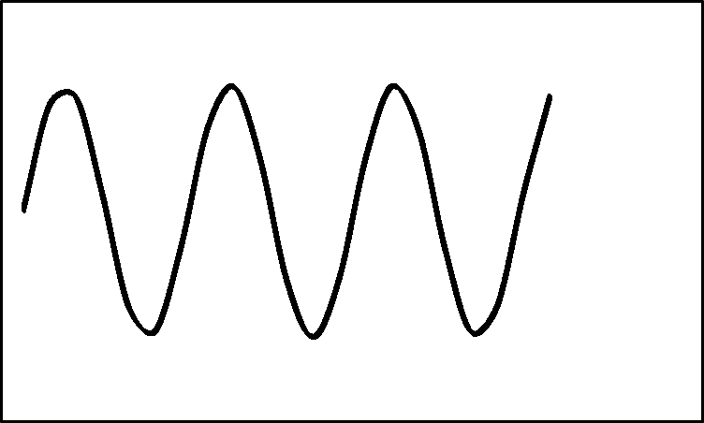
Demonstration

Slide 54
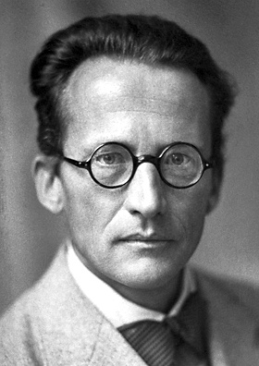
Schroedinger: Waves and Particles
Proposed a model for the arrangement of the electrons in the atom as series of waves confined to particular regions of space
These waves occupy defined volumes called orbitals centred on the nucleus. Electrons are standing waves located in orbitals.
Each orbital has a defined shape and a defined energy.
Orbitals are arranged in order of increasing energy as the atom increases in size and the orbitals are further from the nucleus.

Slide 55
Orbits or orbitals?
Note the difference between orbits and orbitals!
An orbital is a volume of space in which we have a 95% probability of finding the electron. It does not define the position of the electron, it tells us where we are most likely to find it. It is a probabilistic model.
In contrast: orbits are defined paths – an orbit implies that we can calculate the exact speed and position of the electron at a particular point in time (like a planet orbiting the sun). It is a deterministic model.

Slide 56
Orbitals
Schroedinger’s explanation involves some very difficult mathematics but in summary, an electron orbital can be described by three numbers which are related to each other:
The principle quantum number n
The secondary quantum number l
The magnetic quantum number m

Slide 57
The principle quantum number: n
A whole number (integer) starting from 1
Orbitals are arranged in shells.
“n” describes the shell where the electrons are found.
The energy of electrons increases as the shell number increases (they are farther away from the nucleus)
The first shell is 1, the second 2 etc.

Slide 58
The secondary quantum number: l
Has whole number values from:
l = 0 ≤ n-1
It describes the type of orbitals that are found within a sub-shell of a shell.
All of the electrons with the same value for l in a sub-shell have the same energy.

Slide 59
The magnetic quantum number: m
Is a whole number with values from:
-l ≤ 0 ≤ +l
It describes the shape and direction of the orbital.
It is the volume within a sub-shell where an electron may be found.
An orbital can never contain more than 2 electrons.

Slide 60
Electron spin
Each orbital can accommodate two electrons, but how can this be if the electrons are negatively charged and repel each other?
Two electrons can occupy the same orbital because they have a property called spin.
The spins of two electrons in the same orbital are opposite.
This allows them to share the orbital.

Slide 61
Pauli
The Pauli exclusion principle:
“it is impossible for two electrons of a poly-electron atom to have the same values of the four quantum numbers (n, ℓ, m_{ℓ} and m_{s}).”

Slide 62
Types of Orbitals
There are four types of orbitals: s, p, d, f
Each has a different shape and energy.
They can be represented as balloons (see following slides) but remember, this is only a representation of the volume where we are most likely to find the electron.

Slide 63
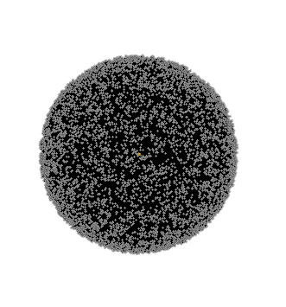
What does this mean?
The lowest energy shell nearest the nucleus has n=1
Therefore the secondary quantum number is …l = 0
And ….m =0
This is the 1s orbital.
It is spherical
It can hold two electrons.
http://www.rasmol.org/software/rasmol/INSTALL.html

Slide 64
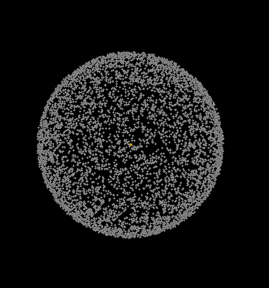
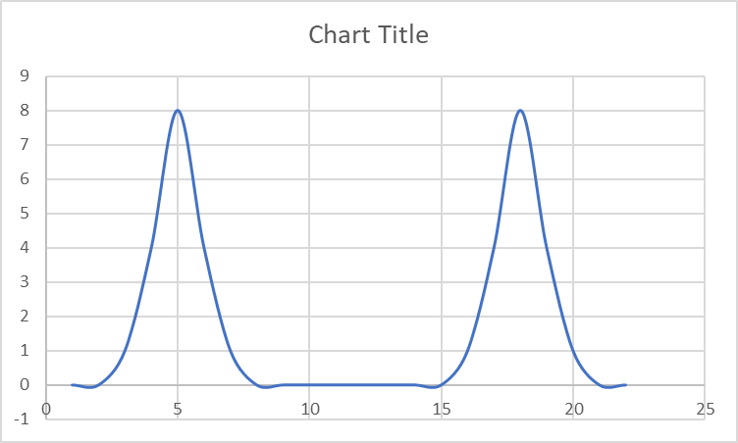
Where are the electrons?
Walking along a line which passes through the nucleus, the electrons can be found around the surface of the sphere. (think of a balloon or a football)
The probability of finding the electron at the nucleus is zero.

Slide 65
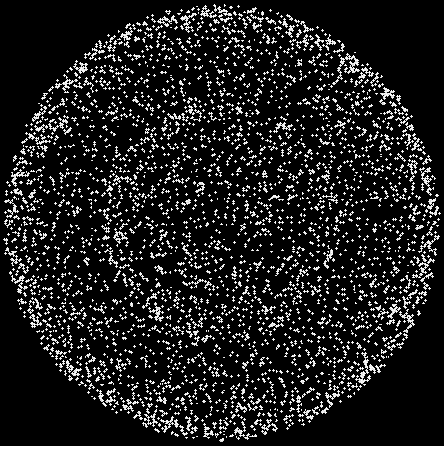
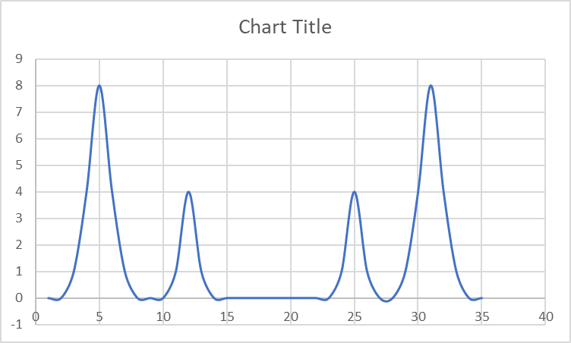
What about the next one?
…n=2 …l = 0….m= 0
  this is the 2s orbital which can also hold two electrons
but we also have an l = 1
… n=2 …l = 1…
therefore m can be = -1, 0, +1
  these are the 2p orbitals
  there are three of them, each of which can hold two electrons.
2s

Slide 66
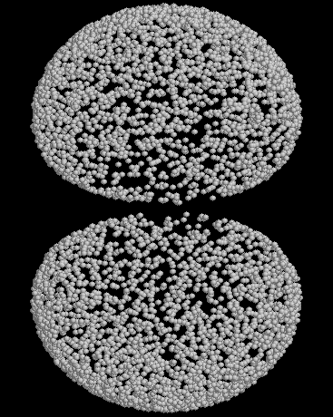
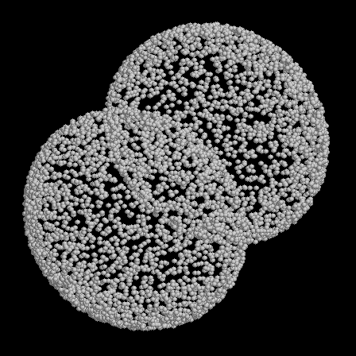
2p orbitals

Slide 67
Shapes of Orbitals
s–orbitals are spherical
  There is only one s-orbital in a shell
p-orbitals have two lobes
  There are three p-orbitals in a shell
  They all have the same energy because they all have l = 1)
  They have different orientations along the x, y, and z cartesian axes.
  Picture ref: http://www.sparknotes.com/chemistry/fundamentals/atomicstructure/section1.rhtml

Slide 68
Shapes of Orbitals
d-orbitals are complex shapes
  There are five d-orbitals in a shell
  They all have the same energy because they all have l = 2
  They have different orientations and shapes along the x, y, and z cartesian axes.
f-orbitals are even more complex
  There are seven f-orbitals in a shell.
  They all have the same energy because they all have l = 3.
  They have different orientations and different shapes along the x, y, and z cartesian axes.
  Picture ref: http://www.sparknotes.com/chemistry/fundamentals/atomicstructure/section1.rhtml

Slide 69
Shapes of orbitals
Link to video demonstrations or use RasWin with Rasmol orbital files

Slide 70
End of section

